Slide 1
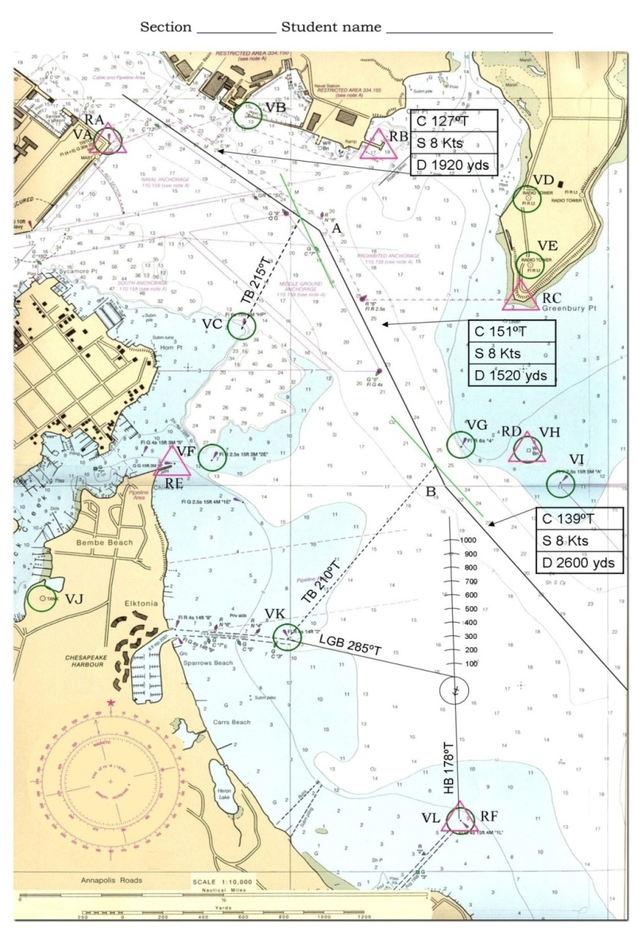
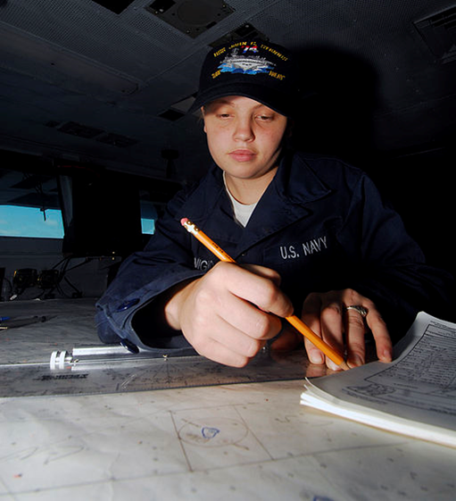
Advanced Plotting

Slide 2
Enabling Objectives
- DEFINE compensating course and compensating speed.
- CALCULATE compensating course and compensating speed.
- DEFINE correcting course and correcting speed.
- CALCULATE correcting course and correcting speed.
- EXPLAIN the purpose of a navigation report.
- GENERATE an accurate navigation report on a three minute fix interval.

Slide 3
Applicability
SWO’s are not the only warfare area that utilize plotting:
Aviation
Submariners
Marine’s

Slide 4
Dead Reckoning
The process of estimating your ship’s future position without considering the effects of wind and current. Based on the ship’s ordered course and speed.
How do we label every DR?
Time + Course + Speed
0900
0903
0906
C: 090°T
S: 10 kts

Slide 5
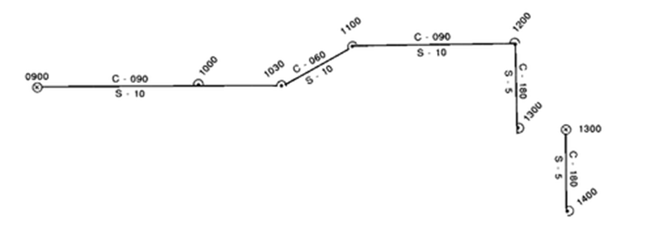
Six Rules of DR
1) Every hour on the hour
2) Every course change
3) Every speed change
4) Every LOP
5) Every fix or running fix
6) Draw a new course line from your fix and dead reckon out two fix intervals
Notes:
Dead Reckoning: The process of estimating your ship’s future position without considering the effects of wind and current.
-Process of estimating your ship’s future position without considering the
effects of wind, current, a wandering helmsman.
-“Best guess”, based only upon course, speed and time.
-Piloting: determining position and directing movements of a vessel by visual reference to landmarks and by measuring depth and radar ranges (piloting waters)
-DR vs. LOP
-DR is statement of intention (calculated position)
-LOP is statement of fact
Helps to:
- Determine when to make course changes or to compute time left on the present course
- Determine when to adjust speed
- Predict the time of sighting lights and other aids to navigation
- Identify landmarks
- Determine which navaids will provide the best fix
- Determine the effects of wind and current on the vessel
- Estimate the ship’s position for celestial navigation computations
- Determine the validity of a fix

Slide 6
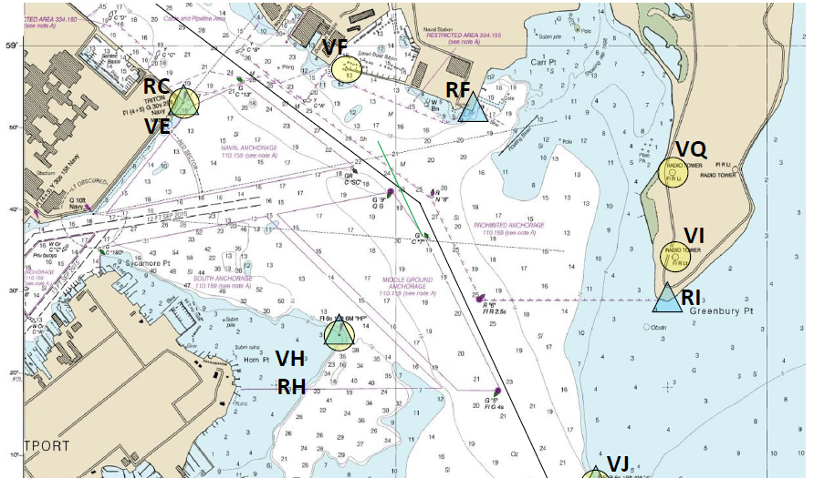
0900
300yds
126T
6kts
D = S * 100
D: distance traveled (yds)
S: speed (kts)
154°
0903
6*100 = 600yds
1,200yds
0906
Ordered Course: 126T
Ordered Speed: 6kts

Slide 7
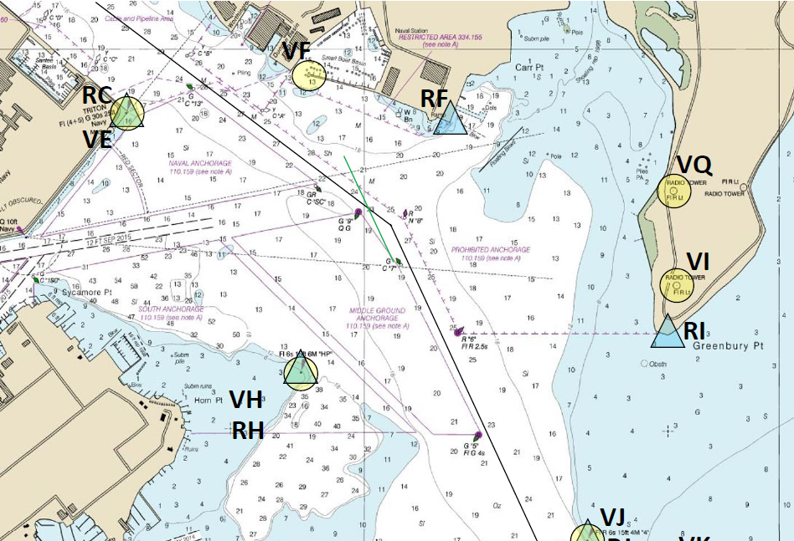
0900
126T
6kts
279°
0903
0903
126T
6kts
111°
190°
0906
0906
0909
Ordered Course: 126T
Ordered Speed: 6kts

Slide 8
Practice on Chartlet Plot your EP for 0906
0900
C 126
S 6
CMG / SMG
0903
0903
C 126
S 6
0906
0906
EP 0906
0909

Slide 9
Current Triangle
Course Made Good (CMG):
-Resultant direction from a given point to a subsequent position.
Speed Made Good (SMG): -Speed based on distance of passage from a given point to a subsequent position.
Ordered Course: The course which is ordered and is steered by the helmsman.
Ordered Speed: The speed which is ordered and is controlled by the lee-helmsman.
Actual Track
0903
Course Made Good Speed Made Good
0903
0906
0900
Ordered Course & Speed

Slide 10
Current Triangle
Set: The direction toward which current is flowing.
Drift: The speed of the current.
Actual Track
0903
Course Made Good Speed Made Good
Set
Off-Set
Drift
DR and fix have to be at same time!!!
0900
0903
Ordered Course & Speed
Offsetting influences: -tidal current -heavy seas -winds
-inaccurate steering -error in engine calibration...

Slide 11
0900
126T
6kts
Ordered Co / Sp
820yds
600yds
Co: 126°T Sp : 6kts
0903
0903
230yds
126T
6kts
Set / Drift
0906
0906
D: distance traveled (yds)
S: speed (kts)
D = S * 100
Set: 105°T Drift: 2.3kts
230yds = S*100 S = 2.3 (kt)
0909
D = S * 100
Co / Sp Made Good
D: distance traveled (yds)
S: speed (kts)
CMG: 121°T SMG: 8.2kts
820yds = S*100 S = 8.2 (kt)

Slide 12
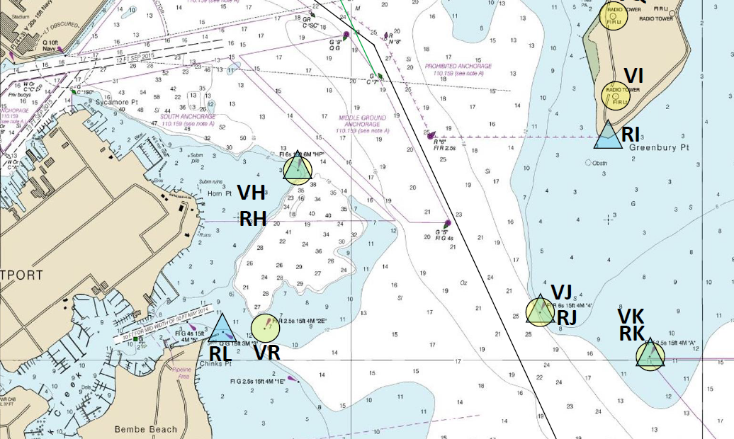
Practice on Chartlet Plot 3rd Fix and DR
0906
C - 155
S - 4
Ordered Course: 155T
Ordered Speed: 4kts
0909
0912

Slide 13
Practice on Chartlet Plot 4th Fix
0906
C - 155
S - 4
0909
0909
C - 155
S- 4
0912
0912
Ordered Course: 155T
Ordered Speed: 4kts
0915

Slide 14
Practice on Chartlet Calculate Set and Drift
0906
C - 155
S - 4
Set: 087T
Drift: 2kts
0909
0909
C - 155
S- 4
0912
0912
0915

Slide 15
Practice on Chartlet Calculate CMG and SMG
0906
C - 155
S - 4
CMG: 136T
SMG: 5 kts
0909
0909
C - 155
S- 4
0912
0912
0915

Slide 16
Practice on Chartlet Estimate your Position at 0912
0906
C - 155
S - 4
CMG: 136T
SMG: 5 kts
0909
0909
C - 155
S- 4
0912
0912
0912
0915

Slide 17
What should you do?
0906
C - 155
S - 4
0909
0909
C - 155
S- 4
0912
0912
0912
Current is deviating your ship from original track. What should you do?
1 – Regain track → Correcting Course
0915
2 – Make good the intended track → Compensating Course

Slide 18
Set & Drift
Direction From DR(D1) to FIX:
Set
(190°)
Distance From DR(D1) to FIX:
Drift
(300yds / 3min)
(3kts)
Ordered Course & Speed
0900
0903
0906
C-090
S- 10
D1
D2
090ºT / 081ºM
190° 300yds
Set & Drift
10 kts
12,000 yds
0903
0906
0909
C-090
Actual Track
S- 10
Course Made Good Speed Made Good

Slide 19
Calculate Correcting Course and Speed
Direction From D3 to DR(D2):
If you don’t alter your course, the position after 3 minutes will be…
(060°)
Distance From D3 to DR(D2):
(1,280yds / 3min)
(12.8kts)
Set & Drift
Correcting Co/Sp
0900
C-090
0903
0906
060° 1,280yds
S- 10
D1
D2
090ºT / 081ºM
190° 300yds
10 kts
12,000 yds
C-090
0906
0909
0903
S- 10
Correcting is… effectively bringing you back to the second DR of your first fix (D2).
190° 300yds
0906
D3

Slide 20
Calculate Compensating Course and Speed
Direction From FIX to DR(D2):
(073°)
×
If you don’t alter your course, the position after 3 minutes will be…
Distance From FIX to DR(D2):
(1,100yds / 3min)
(11kts)
0909
Set / Drift
Compensating Co/Sp
0900
0903
0906
C-090
073° 1,100yds
S- 10
D1
D2
090ºT / 081ºM
190° 300yds
10 kts
×
12,000 yds
0903
0906
0909
C-090
S- 10
0909
Compensating is… Co/Sp in order to compensate for the actual current (Set & Drift).
Co / Sp Made Good :
090° 10kts

Slide 21
Current Triangle
From DR(D1) to FIX :
Set & Drift
(190° 3kts)
From D3 to DR(D2) :
Correcting
(060°12.8kts)
From FIX to DR(D2) :
Compensating
(073°11kts)
0900
0903
0906
C-090
S- 10
D1
D2
Compensating
Set & Drift
0903
0906
0909
C-090
S- 10
Correcting
D3

Slide 22
Correcting Course
What is the correcting course and speed to regain track at 0912?
Expected set / drift
210ºT / 4.4 knots
C 155
S 4
Set and Drift
0909
Correcting Course / Speed
Set: 087T
Drift: 2kts
0909
C 155
S 4
0912
0912
0912

Slide 23
Correcting Course
Once ordered the correcting course and speed, your ship will regain track at 0912!
C 155
S 4
210ºT / 4.4 knots
Remember, the current is still acting on your ship!!!
0909
Correcting Course / Speed
0909
C 155
S 4
0912
0912
0912

Slide 24
Compensating Course
What is the compensating course and speed for the 0909 fix?
183ºT / 3.9 knots
C 155
S 4
0909
Compensating Course / Speed
0909
C 155
S 4
0912
0912
0912

Slide 25
Compensating Course
Once you’ve ordered the compensating course and speed, your ship will make good the original intended Course and Speed!
C 155
S 4
183ºT / 3.9 knots
0909
Compensating Course / Speed
Set: 087T
Drift: 2kts
0909
C 155
S 4
0912
Remember, the current is still acting on your ship!!!
0912
0912

Slide 26
Compensating Course
Once you’ve ordered the compensating course and speed, your ship will make good the original intended Course and Speed!
C 155
S 4
183ºT / 3.9 knots
Set: 087T
Drift: 2kts
0909
C 155
S 4
0912
0912
Remember, the current is still acting on your ship!!!
0912
0912
Compensating Course / Speed

Slide 27
Practice
From DR(D1) to FIX :
Set & Drift
(206° 5.5 kts)
From D3 to DR(D2) :
Correcting
(334°10.8 kts)
From FIX to DR(D2) :
Compensating
(304° 8.8 kts)
Ordered Course & Speed
270°10 kts
0806
0803
0800
D2
D1
C:270T S:10kts
880yds
550yds
0809
0806
0803
Course Made Good Speed Made Good
C:270T S:10kts
1,080yds
550yds
248°13 kts
D3

Slide 28
Practice
D2
1200
1203
1206
000°T/003°M
10 kts
Set & Drift
(264° 5 kts)
1203
1206
1460yds
1160yds
1209
Correcting
(041°14.6 kts)
500yds
Compensating
(025°11.6 kts)
D3
D1
500yds
Ordered Course & Speed
000°10 kts
Course Made Good Speed Made Good
334°10.6 kts

Slide 29
Navigation Report
- Given by the Navigator to Conning Officer and OOD
Purpose: To inform Bridge watch standers of the relevant information acquired from chart based on a fix.
Generally, the navigation labor is split between
a plotter (plots the position) and navigator
(completes the nav report).
YOU WILL HAVE TO DO BOTH FOR THE EXERCISE

Slide 30
Navigation Report
Based off a(n) (excellent/good/fair/poor) (visual/electronic/composite) fix at time ______ navigation holds you (on track/right of track by __________ /left of track by __________). Navigation recommends you (maintain course and speed/alter course and speed to _________ to regain track). The nearest hazard to navigation is _________________, _________ yards off the (starboard/port) (bow/beam/quarter). The nearest aid to navigation is _________________, _________ yards off the (starboard/port) (bow/beam/quarter). There is ______ feet beneath the keel; this (concurs / does not concur) with charted depth. Distance to turn is ___________ yards. Time to turn is __________________. Next course is __________________ degrees True.
Set and Drift is __________________degrees True at __________________knots.
‹#›

Slide 31
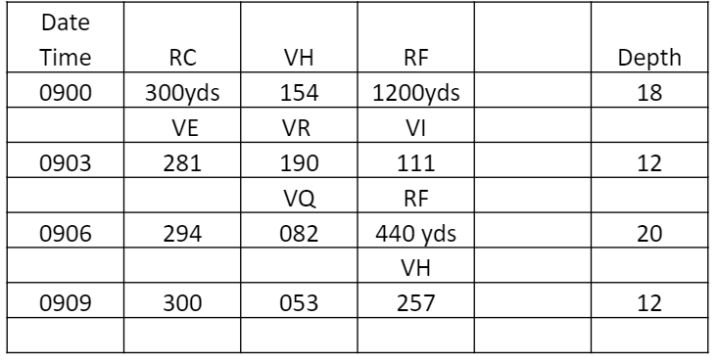
Practice !
(Actual Draft: 7ft)
Ordered Course: 155 °T
Ordered Speed: 4 kts

Slide 32
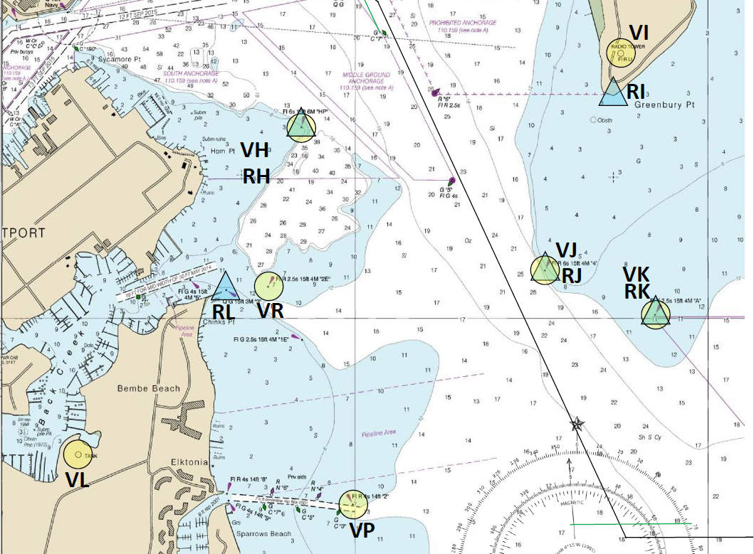
0906
088°
238°
C 155
S 4
1,070yds
0909
0912
Notes:
120%

Slide 33
Navigation Report for 0906
Based off a(n) (excellent/good/fair/poor) (visual/electronic/composite) fix at time ______
navigation holds you (on track/right of track by __________ /left of track by __________).
Navigation recommends you (maintain course and speed/alter course and speed to _________ to regain track).
The nearest hazard to navigation is _________________, _________ yards off the (starboard/port) (bow/beam/quarter).
The nearest aid to navigation is _________________, _________ yards off the (starboard/port) (bow/beam/quarter).
There is ______ feet beneath the keel; this (concurs / does not concur) with charted depth.
Distance to turn is ___________ yards. Time to turn is __________________.
Next course is __________________ degrees True.
Set and Drift is __________________degrees True at ________________knots.
If the LOPs were based only on visual
If the LOPs were based only on electrical means(RADAR, GPS)
If the LOPs were based both on visual and RADAR

Slide 34
Navigation Report for 0906
Based off a(n) (excellent/good/fair/poor) (visual/electronic/composite) fix at time ______
navigation holds you (on track/right of track by __________ /left of track by __________).
Navigation recommends you (maintain course and speed/alter course and speed to _________ to regain track).
The nearest hazard to navigation is _________________, _________ yards off the (starboard/port) (bow/beam/quarter).
The nearest aid to navigation is _________________, _________ yards off the (starboard/port) (bow/beam/quarter).
There is ______ feet beneath the keel; this (concurs / does not concur) with charted depth.
Distance to turn is ___________ yards. Time to turn is __________________.
Next course is __________________ degrees True.
Set and Drift is __________________degrees True at ________________knots.
Based off a(n) (excellent/good/fair/poor) (visual/electronic/composite) fix at time 0906

Slide 35
Navigation Report for 0906
Based off a(n) (excellent/good/fair/poor) (visual/electronic/composite) fix at time ______
navigation holds you (on track/right of track by __________ /left of track by __________).
Navigation recommends you (maintain course and speed/alter course and speed to _________ to regain track).
The nearest hazard to navigation is _________________, _________ yards off the (starboard/port) (bow/beam/quarter).
The nearest aid to navigation is _________________, _________ yards off the (starboard/port) (bow/beam/quarter).
There is ______ feet beneath the keel; this (concurs / does not concur) with charted depth.
Distance to turn is ___________ yards. Time to turn is __________________.
Next course is __________________ degrees True.
Set and Drift is __________________degrees True at ________________knots.
Based off a(n) (excellent/good/fair/poor) (visual/electronic/composite) fix at time 0906
INSTRUCTION in this Class
You must alter course to regain track if you are off track GREATER THAN 50yds.

Slide 36
0906
C-155
S-6
0909
0912
Notes:
120%

Slide 37
Navigation Report for 0906
Based off a(n) (excellent/good/fair/poor) (visual/electronic/composite) fix at time ______
navigation holds you (on track/right of track by __________ /left of track by __________).
Navigation recommends you (maintain course and speed/alter course and speed to _________ to regain track).
The nearest hazard to navigation is _________________, _________ yards off the (starboard/port) (bow/beam/quarter).
The nearest aid to navigation is _________________, _________ yards off the (starboard/port) (bow/beam/quarter).
There is ______ feet beneath the keel; this (concurs / does not concur) with charted depth.
Distance to turn is ___________ yards. Time to turn is __________________.
Next course is __________________ degrees True.
Set and Drift is __________________degrees True at ________________knots.
Based off a(n) (excellent/good/fair/poor) (visual/electronic/composite) fix at time 0906
Navigation holds you (on track/right of track by __________/ left of track by __________).
Navigation recommends you (maintain course and speed/alter course and speed to _________ to regain track). ).

Slide 38
Navigation Report for 0906
Based off a(n) (excellent/good/fair/poor) (visual/electronic/composite) fix at time ______
navigation holds you (on track/right of track by __________ /left of track by __________).
Navigation recommends you (maintain course and speed/alter course and speed to _________ to regain track).
The nearest hazard to navigation is _________________, _________ yards off the (starboard/port) (bow/beam/quarter).
The nearest aid to navigation is _________________, _________ yards off the (starboard/port) (bow/beam/quarter).
There is ______ feet beneath the keel; this (concurs / does not concur) with charted depth.
Distance to turn is ___________ yards. Time to turn is __________________.
Next course is __________________ degrees True.
Set and Drift is __________________degrees True at ________________knots.
Based off a(n) (excellent/good/fair/poor) (visual/electronic/composite) fix at time 0906
Navigation holds you (on track/right of track by __________/ left of track by __________).
Navigation recommends you (maintain course and speed/alter course and speed to _________ to regain track).

Slide 39
0900
0900
126T
6kts
126T
6kts
0903
0903
0903
250yds
126T
6kts
0906
0906
×
0906
0906
155T
6kts
0909
Calculate Set & Drift when you have two consecutive fixes
on the same Co / Sp
0909

Slide 40
Navigation Report for 0906
Based off a(n) (excellent/good/fair/poor) (visual/electronic/composite) fix at time ______
navigation holds you (on track/right of track by __________ /left of track by __________).
Navigation recommends you (maintain course and speed/alter course and speed to _________ to regain track).
The nearest hazard to navigation is _________________, _________ yards off the (starboard/port) (bow/beam/quarter).
The nearest aid to navigation is _________________, _________ yards off the (starboard/port) (bow/beam/quarter).
There is ______ feet beneath the keel; this (concurs / does not concur) with charted depth.
Distance to turn is ___________ yards. Time to turn is __________________.
Next course is __________________ degrees True.
Set and Drift is __________________degrees True at ________________knots.
Based off a(n) (excellent/good/fair/poor) (visual/electronic/composite) fix at time 0906
Navigation holds you (on track/right of track by __________/ left of track by __________).
Navigation recommends you (maintain course and speed/alter course and speed to _________ to regain track). ).
Set and Drift is N/A degrees True at N/A knots.

Slide 41
Navigation Report for 0906
Based off a(n) (excellent/good/fair/poor) (visual/electronic/composite) fix at time ______
navigation holds you (on track/right of track by __________ /left of track by __________).
Navigation recommends you (maintain course and speed/alter course and speed to _________ to regain track).
The nearest hazard to navigation is _________________, _________ yards off the (starboard/port) (bow/beam/quarter).
The nearest aid to navigation is _________________, _________ yards off the (starboard/port) (bow/beam/quarter).
There is ______ feet beneath the keel; this (concurs / does not concur) with charted depth.
Distance to turn is ___________ yards. Time to turn is __________________.
Next course is __________________ degrees True.
Set and Drift is __________________degrees True at ________________knots.
Based off a(n) (excellent/good/fair/poor) (visual/electronic/composite) fix at time 0906
Hazards to Navigation:
- Select absolute nearest hazard
- NAVAIDs are not hazards.
Navigation holds you (on track/right of track by __________/ left of track by __________).
Hazards to Navigation:
Shoal water, Wreck,
Other vessel anchored etc.
Navigation recommends you (maintain course and speed/alter course and speed to _________ to regain track). ).
Aids to Navigation:
Remember, you’re talking to the CONN.
Pick a NAVAID preferably ahead of your vessel so they can look out at it while still keeping a good lookout. Astern is no other options
Aids to Navigation:
Light, Buoy, Daymark, etc.
Set and Drift is N/A degrees True at N/A knots.

Slide 42
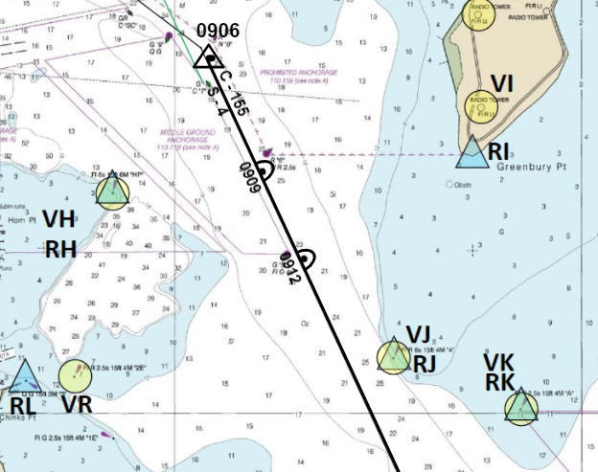
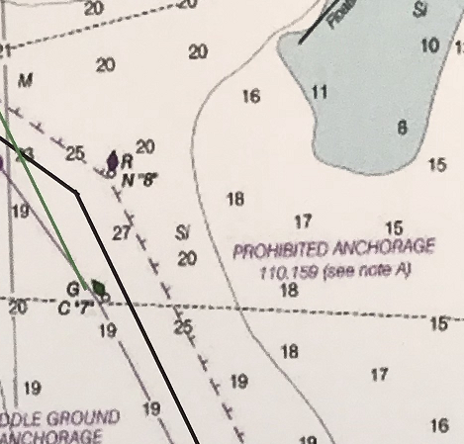
Shoal Water
370yds
Notes:
120%

Slide 43
Navigation Report for 0906
Based off a(n) (excellent/good/fair/poor) (visual/electronic/composite) fix at time ______
navigation holds you (on track/right of track by __________ /left of track by __________).
Navigation recommends you (maintain course and speed/alter course and speed to _________ to regain track).
The nearest hazard to navigation is _________________, _________ yards off the (starboard/port) (bow/beam/quarter).
The nearest aid to navigation is _________________, _________ yards off the (starboard/port) (bow/beam/quarter).
There is ______ feet beneath the keel; this (concurs / does not concur) with charted depth.
Distance to turn is ___________ yards. Time to turn is __________________.
Next course is __________________ degrees True.
Set and Drift is __________________degrees True at ________________knots.
Based off a(n) (excellent/good/fair/poor) (visual/electronic/composite) fix at time 0906
Navigation holds you (on track/right of track by __________/ left of track by __________).
Navigation recommends you (maintain course and speed/alter course and speed to _________ to regain track). ).
The nearest hazard to navigation is shoal water, 370yds off the (starboard/port) (bow/beam/quarter).
P
BOW
PORT
STBD
BEAM
BEAM
QUARTER
QUARTER
Set and Drift is N/A degrees True at N/A knots.
STERN

Slide 44
300yds
Buoy
Notes:
120%

Slide 45
Navigation Report for 0906
Based off a(n) (excellent/good/fair/poor) (visual/electronic/composite) fix at time ______
navigation holds you (on track/right of track by __________ /left of track by __________).
Navigation recommends you (maintain course and speed/alter course and speed to _________ to regain track).
The nearest hazard to navigation is _________________, _________ yards off the (starboard/port) (bow/beam/quarter).
The nearest aid to navigation is _________________, _________ yards off the (starboard/port) (bow/beam/quarter).
There is ______ feet beneath the keel; this (concurs / does not concur) with charted depth.
Distance to turn is ___________ yards. Time to turn is __________________.
Next course is __________________ degrees True.
Set and Drift is __________________degrees True at ________________knots.
Based off a(n) (excellent/good/fair/poor) (visual/electronic/composite) fix at time 0906
Navigation holds you (on track/right of track by __________/ left of track by __________).
Navigation recommends you (maintain course and speed/alter course and speed to _________ to regain track). ).
The nearest hazard to navigation is shoal water, 370yds off the (starboard/port) (bow/beam/quarter).
The nearest aid to navigation is Red No.6 Buoy, 300 yds off the (starboard/port) (bow/beam/quarter).
Set and Drift is N/A degrees True at N/A knots.

Slide 46
Navigation Report for 0906
Based off a(n) (excellent/good/fair/poor) (visual/electronic/composite) fix at time ______
navigation holds you (on track/right of track by __________ /left of track by __________).
Navigation recommends you (maintain course and speed/alter course and speed to _________ to regain track).
The nearest hazard to navigation is _________________, _________ yards off the (starboard/port) (bow/beam/quarter).
The nearest aid to navigation is _________________, _________ yards off the (starboard/port) (bow/beam/quarter).
There is ______ feet beneath the keel; this (concurs / does not concur) with charted depth.
Distance to turn is ___________ yards. Time to turn is __________________.
Next course is __________________ degrees True.
Set and Drift is __________________degrees True at ________________knots.
Based off a(n) (excellent/good/fair/poor) (visual/electronic/composite) fix at time 0906
Navigation holds you (on track/right of track by __________/ left of track by __________).
Navigation recommends you (maintain course and speed/alter course and speed to _________ to regain track). ).
The nearest hazard to navigation is shoal water, 370yds off the (starboard/port) (bow/beam/quarter).
The nearest aid to navigation is Red No.6 Buoy, 300 yds off the (starboard/port) (bow/beam/quarter).
Set and Drift is N/A degrees True at N/A knots.

Slide 47
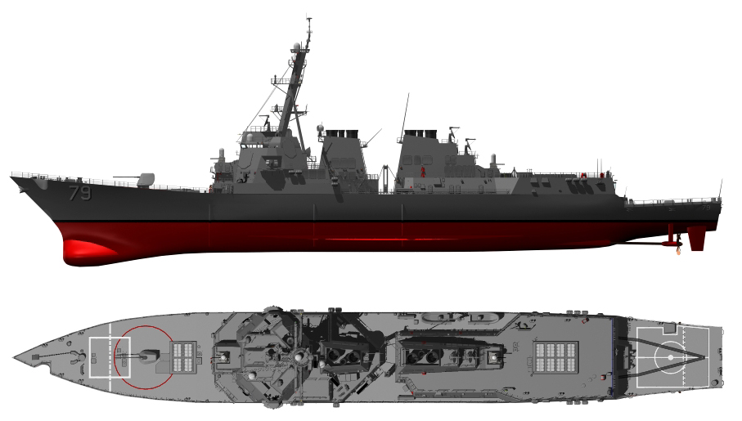
(Actual Draft: 7ft)
beneath the keel
Waterline
6 ft
19 ft
Draft
Keel
13 ft
Fathometer
Depth beneath the keel
Sea Floor
Add your draft to the fathometer

Slide 48
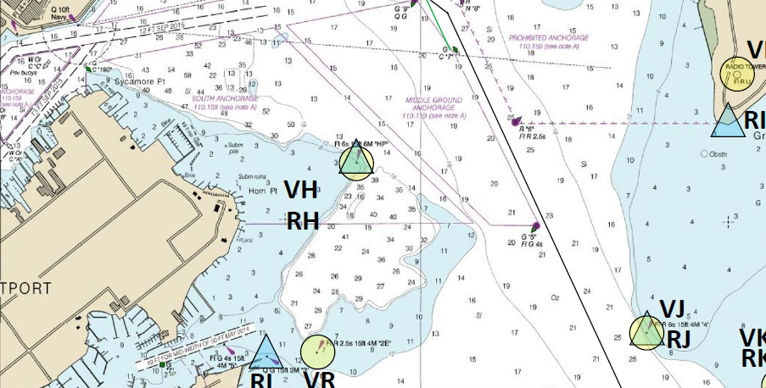
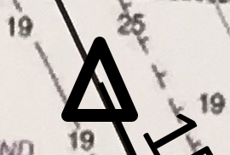
0906
C-155
S-6
0909
19
0912
Notes:
120%

Slide 49
Navigation Report for 0906
Based off a(n) (excellent/good/fair/poor) (visual/electronic/composite) fix at time ______
navigation holds you (on track/right of track by __________ /left of track by __________).
Navigation recommends you (maintain course and speed/alter course and speed to _________ to regain track).
The nearest hazard to navigation is _________________, _________ yards off the (starboard/port) (bow/beam/quarter).
The nearest aid to navigation is _________________, _________ yards off the (starboard/port) (bow/beam/quarter).
There is ______ feet beneath the keel; this (concurs / does not concur) with charted depth.
Distance to turn is ___________ yards. Time to turn is __________________.
Next course is __________________ degrees True.
Set and Drift is __________________degrees True at ________________knots.
Based off a(n) (excellent/good/fair/poor) (visual/electronic/composite) fix at time 0906
Navigation holds you (on track/right of track by __________/ left of track by __________).
Navigation recommends you (maintain course and speed/alter course and speed to _________ to regain track). ).
The nearest hazard to navigation is shoal water, 370yds off the (starboard/port) (bow/beam/quarter).
The nearest aid to navigation is Red No.6 Buoy, 300 yds off the (starboard/port) (bow/beam/quarter).
There is 13 feet beneath the keel; this (concurs / does not concur) with charted depth.
Set and Drift is N/A degrees True at N/A knots.

Slide 50
Navigation Report for 0906
Based off a(n) (excellent/good/fair/poor) (visual/electronic/composite) fix at time ______
navigation holds you (on track/right of track by __________ /left of track by __________).
Navigation recommends you (maintain course and speed/alter course and speed to _________ to regain track).
The nearest hazard to navigation is _________________, _________ yards off the (starboard/port) (bow/beam/quarter).
The nearest aid to navigation is _________________, _________ yards off the (starboard/port) (bow/beam/quarter).
There is ______ feet beneath the keel; this (concurs / does not concur) with charted depth.
Distance to turn is ___________ yards. Time to turn is __________________.
Next course is __________________ degrees True.
Set and Drift is __________________degrees True at ________________knots.
Based off a(n) (excellent/good/fair/poor) (visual/electronic/composite) fix at time 0906
Navigation holds you (on track/right of track by __________/ left of track by __________).
Navigation recommends you (maintain course and speed/alter course and speed to _________ to regain track). ).
The nearest hazard to navigation is shoal water, 370yds off the (starboard/port) (bow/beam/quarter).
The nearest aid to navigation is Red No.6 Buoy, 300 yds off the (starboard/port) (bow/beam/quarter).
There is 13 feet beneath the keel; this (concurs / does not concur) with charted depth.
Set and Drift is N/A degrees True at N/A knots.

Slide 51
0906
D = S × T
155T
6kts
1.1 NM (2,200yds) = 6 kt × T
T = 1.1 / 6
= 0.1833… (h) ⇒ 11.0 (min)
0909
0912
2,200yds
Distance measured to slide bar
Notes:
120%

Slide 52
Navigation Report for 0906
Based off a(n) (excellent/good/fair/poor) (visual/electronic/composite) fix at time ______
navigation holds you (on track/right of track by __________ /left of track by __________).
Navigation recommends you (maintain course and speed/alter course and speed to _________ to regain track).
The nearest hazard to navigation is _________________, _________ yards off the (starboard/port) (bow/beam/quarter).
The nearest aid to navigation is _________________, _________ yards off the (starboard/port) (bow/beam/quarter).
There is ______ feet beneath the keel; this (concurs / does not concur) with charted depth.
Distance to turn is ___________ yards. Time to turn is __________________.
Next course is __________________ degrees True.
Set and Drift is __________________degrees True at ________________knots.
Based off a(n) (excellent/good/fair/poor) (visual/electronic/composite) fix at time 0906
Navigation holds you (on track/right of track by __________/ left of track by __________).
Navigation recommends you (maintain course and speed/alter course and speed to _________ to regain track). ).
The nearest hazard to navigation is shoal water, 370yds off the (starboard/port) (bow/beam/quarter).
The nearest aid to navigation is Red No.6 Buoy, 300 yds off the (starboard/port) (bow/beam/quarter).
There is 13 feet beneath the keel; this (concurs / does not concur) with charted depth.
Distance to turn is 2,200 yards. Time to turn is 11min.
Set and Drift is N/A degrees True at N/A knots.

Slide 53
0906
C-155
S-6
0909
0912
Notes:
120%

Slide 54
Navigation Report for 0906
Based off a(n) (excellent/good/fair/poor) (visual/electronic/composite) fix at time ______
navigation holds you (on track/right of track by __________ /left of track by __________).
Navigation recommends you (maintain course and speed/alter course and speed to _________ to regain track).
The nearest hazard to navigation is _________________, _________ yards off the (starboard/port) (bow/beam/quarter).
The nearest aid to navigation is _________________, _________ yards off the (starboard/port) (bow/beam/quarter).
There is ______ feet beneath the keel; this (concurs / does not concur) with charted depth.
Distance to turn is ___________ yards. Time to turn is __________________.
Next course is __________________ degrees True.
Set and Drift is __________________degrees True at ________________knots.
Based off a(n) (excellent/good/fair/poor) (visual/electronic/composite) fix at time 0906
Navigation holds you (on track/right of track by __________/ left of track by __________).
Navigation recommends you (maintain course and speed/alter course and speed to _________ to regain track). ).
The nearest hazard to navigation is shoal water, 370yds off the (starboard/port) (bow/beam/quarter).
The nearest aid to navigation is Red No.6 Buoy, 300 yds off the (starboard/port) (bow/beam/quarter).
There is 13 feet beneath the keel; this (concurs / does not concur) with charted depth.
Distance to turn is 2,200 yards. Time to turn is 11min.
Next course is 090 degrees True.
Set and Drift is N/A degrees True at N/A knots.

Slide 55
Practice !
(Actual Draft: 7ft)
Ordered Course: 155 °T
Ordered Speed: 4 kts

Slide 56
Practice on Chartlet Plot 4th Fix
0906
C-155
S-4
0909
0909
C-155
S-4
0912
0912
Ordered Course: 155T
Ordered Speed: 4kts
0915

Slide 57
Practice on Chartlet Calculate Set and Drift
C-155
S -4
Set: 087 T
Drift: 2kts
0909
0909
C-155
S-4
0912
0912
0915

Slide 58
Practice on Chartlet Calculate CMG and SMG
C - 155
S - 4
CMG: 136T
SMG: 5 kts
0909
0909
C-155
S-4
0912
0912
0915

Slide 59
Practice on Chartlet Estimate your Position at 0912
C - 155
S - 4
0909
0909
C-155
S-4
0912
0912
0912
0915

Slide 60
Navigation Report for 0909
Based off a(n) (excellent/good/fair/poor) (visual/electronic/composite) fix at time ______
navigation holds you (on track/right of track by __________ /left of track by __________).
Navigation recommends you (maintain course and speed/alter course and speed to _________ to regain track).
The nearest hazard to navigation is _________________, _________ yards off the (starboard/port) (bow/beam/quarter).
The nearest aid to navigation is _________________, _________ yards off the (starboard/port) (bow/beam/quarter).
There is ______ feet beneath the keel; this (concurs / does not concur) with charted depth.
Distance to turn is ___________ yards. Time to turn is __________________.
Next course is __________________ degrees True.
Set and Drift is __________________degrees True at ________________knots.
Based off a(n) (excellent/good/fair/poor) (visual/electronic/composite) fix at time 0909
Navigation holds you (on track/right of track by /left of track by _180 yards__).
Navigation recommends you (maintain course and speed/ alter course and speed to 210° 4.4kts to regain track). ).
The nearest hazard to navigation is shoal water, 170yds off the (starboard/port) (bow/beam/quarter).
The nearest aid to navigation is Red DayMarker, 550 yds off the (starboard/port) (bow/beam/quarter).
There is 14 feet beneath the keel; this (concurs / does not concur) with charted depth.
Distance to turn is 1,580 yards. Time to turn is 8min.
Next course is 090 degrees True.
Set and Drift is 087° degrees True at 2 knots.

Slide 61
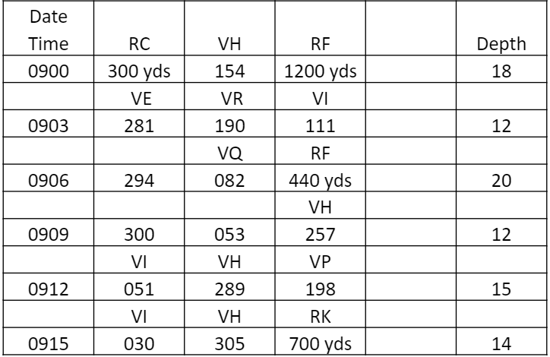
Practice !
(Actual Draft: 7ft)
Ordered Course: 134 °T
Ordered Speed: 6.7 kts

Slide 62
0906
C-155
S-6
0909
0909
C-155
S-6
310°
0912
0912
0912
090°
C-134
S-6.7
123°
0915
0915
Notes:
120%

Slide 63
0906
C-155
S-6
Compensating Course & Speed
0909
0909
C-155
S-6
144° 6.4kts
0912
0912
0912
Co/Sp
Made Good
C-134
S-6.7
155° 6 kts
0915
0915
Notes:
120%

Slide 64
Navigation Report for 0912
Based off a(n) (excellent/good/fair/poor) (visual/electronic/composite) fix at time ______
navigation holds you (on track/right of track by __________ /left of track by __________).
Navigation recommends you (maintain course and speed/alter course and speed to _________ to regain track).
The nearest hazard to navigation is _________________, _________ yards off the (starboard/port) (bow/beam/quarter).
The nearest aid to navigation is _________________, _________ yards off the (starboard/port) (bow/beam/quarter).
There is ______ feet beneath the keel; this (concurs / does not concur) with charted depth.
Distance to turn is ___________ yards. Time to turn is __________________.
Next course is __________________ degrees True.
Set and Drift is __________________degrees True at ________________knots.
Based off a(n) (excellent/good/fair/poor) (visual/electronic/composite) fix at time 0912
Navigation holds you (on track/right of track by __________ /left of track by 10yds).
Navigation recommends you (maintain course and speed/alter course and speed to 144° 6.4kts to compensate for current).
The nearest hazard to navigation is shoal water, 180yds off the (starboard/port) (bow/beam/quarter).
The nearest aid to navigation is Day Marker “4”, 540 yds off the (starboard/port) (bow/beam/quarter).
There is 13 feet beneath the keel; this (concurs / does not concur) with charted depth.
Distance to turn is 970 yards. Time to turn is 5min.
Next course is 090 degrees True.
Set and Drift is 250 degrees True at 1.2 knots.

Slide 65
Practice !
(Actual Draft: 7ft)
Ordered Course: 144 °T
Ordered Speed: 6.4 kts

Slide 66
0906
C-155
S-6
What course and speed would you recommend on the 0915 NAV Report?
0909
0909
0912
0912
Keep on the Compensating course until Set/Drift or base Course changes!
0912
C-134
S-6.7
0915
0915
0915
Notes:
120%

Slide 67
Questions ?

